Slide 1
An Efficient Technique for Exploring Register File Size in ASIP Synthesis
Presenter Manoj Kumar Jain
http://www.cse.iitd.ernet.in/~manoj
Supervisors Prof. M. Balakrishnan and Prof. Anshul Kumar
Department of Computer Science & Engineering
IIT Delhi
CASES 2002, October 8-11, 2002 Grenoble France

Slide 2
Outline
ASIP introduction
Overall Objectives
Register File Size exploration
Results and Validation
Conclusions and future work

Slide 3
GPP-ASIP-ASIC
ASIPs (Application Specific Instruction Set Processors)
Designed for specific application
Exploits special characteristics to meet the desired constraints
Efficient for applications like digital signal processing, automatic control systems, cellular phones etc.
 | GPP | ASIP | ASIC
Performance | Low | High | Very High
Flexibility | Excellent | Good | Poor
HW Design Effort | Nil | Large | Very Large
SW Design Effort | Small | Large | Nil
Power | Large | Medium | Small
Reuse | Excellent | Good | Poor
Markets | Very Large | Relatively large | Small
Cost | Mainly on SW | S-O-C | Volume sensitive

Slide 4
Flow Diagram of ASIP Design Methodology
Application &
Design Constraints
Application Analysis
Architectural Design Space Exploration
Instruction Set
Generation
Code Synthesis
Hardware Synthesis
Object Code
Processor Description

Slide 5
Approaches in ASIP Design Space Exploration
Efficient retargetable compiler and simulator required
Slower
More accurate
More architectural features have been explored
Application
(C)
Retargetable
Compiler
Object
Code
Retargetable
Simulator
Simulator based
Architecture
Description
Trace Data
No target specific code generation
Faster
Less accurate
Less architectural features have been explored
Application
(C)
Architecture
Description
Profiler
Retargetable
Estimator
Scheduler based
Performance and
other Estimates

Slide 6
Previous work on Storage Exploration
Register banks , I/D-Cache [Gloria90, Gong95, Kin99]
Attempt to optimize register count based on profiler information but method needs code generation and analysis [Honma94]
Language based approach [Mishra2001]

Slide 7
What needs to be done and overall objectives
Increasing dimensions of design space
Design space exploration needs to be very fast
Storage organization to be explored by scheduler based approach
Exploring Register File Size, Cache design space and other storage structures

Slide 8
Register Size Evaluation: Problem Definition
Fast performance estimation with varying register file sizes in a scheduler based approach
Register file size evaluation based on performance estimates, suitable cost models and constraints

Slide 9
Register Size Evaluation: Motivating Study
Study the impact of changing the number of
registers on
Performance (# cycles), Power, Energy and Code size
Experimental Framework
Wehmeyer/ Jain TCAD 2001
C Code
encc
assembly
Assembler &
Linker
executable
energy
database
profiling
information
trace
analyzer
trace file
ISS

Slide 10
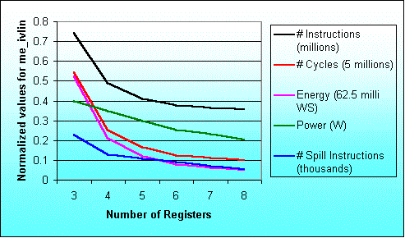
Result for the program me_ivlin
knee due to exec. time reduction
knee due to power saving

Slide 11
Observations from this study
An increase in the number of registers by one can result up to 57.5% performance improvement and up to 62.9% reductions in energy consumption
High degree of correlation between performance improvement and energy reduction
Power does not strongly depend on number of registers
New technique should be developed for fast exploration of register file size

Slide 12
New Technique for Register File Size Evaluation
Scheduler based approach
Code generator as well as simulator not required
Fast compared to simulator based techniques
Validated for ARM7TDMI, TM-1000 and Leon
Simple machine description
Easily Retargetable

Slide 13
Register file size evaluation methodology
Application
Profiling
Processor description
SUIF
Profile information
SUIF IR
Dependence analysis
Control flow graph
Data flow graph
Local register allocation
using reuse chains
Estimate overhead to
handle global needs
For each Basic Block
Modified data flow graph
Local execution time estimate
Schedule overhead
due to global needs
Scheduling
For each function
Schedule estimate of single
execution of the basic block
Execution time estimates

Slide 14
Register allocation using Register Reuse Chains
A Register Reuse Chain or RRC contain
all the variables assigned to the same register
Generating Initial Chains (adopted from Zhang’s approach)
Converting Initial Chains into dependence conservative chains (adopted from Zhang’s approach)
Computing merging costs (Our contribution)
Efficiently merging chains (Our Contribution)

Slide 15
Illustrative Example
l_2
a
load a;
b=2*a;
c=a+3;
d=a-4;
e=c*d;
f=c-d;
g=e/f;
h=g+5;
i=h*6;
j=h+7;
k=i/j;
l=b+k;
l_3
l_4
b
c
d
e
f
g
l_5
Source Code
h
l_6
l_7
Dependency Graph
l_x constant x loaded into reg
i
j
k
l

Slide 16
Generating Initial Reuse Chains
Earliest Ultimate Killing (EUK) Node is the earliest node where Variable’s live range is guaranteed to end
Earliest Ultimate Killing or EUK nodes are used to construct RRCs
Basic Idea Recursively search the EUK nodes and assign the same register.

Slide 17
Reuse chains formation
l_2
a
Variable EUK
a l
l_2 b
b l
l_3 c
c g
l_4 d
d g
e g
f g
g h
l_5 h
h k
l_6 i
i k
l_7 j
j k
k l
l l
l_3
l_4
b
c
d
Initial Chains
Chain 0 < a, l >
Chain 1 < l_2, b >
Chain 2 < l_3, c, g, h, k >
Chain 3 < l_4, d, i >
Chain 4 < l_5, j >
Chain 5 < l_6 >
Chain 6 < l_7 >
Chain 7 < e >
Chain 8 < f >
e
f
g
l_5
h
l_6
l_7
Dependency Graph
i
j
k
l

Slide 18
Reuse chains formation
l_2
a
Initial Chains
Chain 0 < a, l >
Chain 1 < l_2, b >
Chain 2 < l_3, c, g, h, k >
Chain 3 < l_4, d, i >
Chain 4 < l_5, j >
Chain 5 < l_6 >
Chain 6 < l_7 >
Chain 7 < e >
Chain 8 < f >
Variable EUK
a l
l_2 b
b l
l_3 c
c g
l_4 d
d g
e g
f g
g h
l_5 h
h k
l_6 i
i k
l_7 j
j k
k l
l l
l_3
l_4
b
c
d
e
f
g
Dependence conservative chains
Chain 0 < a >
Chain 1 < l_2, b, l >
Chain 2 < l_3, c, e, g, h, i, k >
Chain 3 < l_4, d >
Chain 4 < l_5 >
Chain 5 < l_6 >
Chain 6 < l_7, j >
Chain 7 < f >
l_5
h
l_6
l_7
Dependency Graph
i
j
k
l

Slide 19
Computing merging costs
l_2
a
Dependence conservative chains
Chain 0 < a >
Chain 1 < l_2, b, l >
Chain 2 < l_3, c, e, g, h, i, k >
Chain 3 < l_4, d >
Chain 4 < l_5 >
Chain 5 < l_6 >
Chain 6 < l_7, j >
Chain 7 < f >
l_3
l_4
b
c
d
e
f
g
l_5
l_7
M _{5,6} = 2
M _{6,5} = 4
h
l_6
l_6
l_7
j
Dependency Graph
i
j
i
k
l
k

Slide 20
Local Execution Cycles Estimates with diff. Register File Sizes
k | Sets | LE _{B,k}
>7 | <a>, <l_2,b,l>, <l_3,c,e,g,h,i,k>, <l_4,d>, <l_5>, <l_6>, <l_7,j>, <f> | 29
7 | <a>, <l_2,b,l>, <l_3,c,e,g,h,i,k>, <l_4,d,l_5,l_6>, <l_7,j>, <f> | 35
6 | <a>, <l_3,c,e,g,h,i,k>, <l_4,d,l_5,l_6,l_2,b,l>, <l_7,j>, <f> | 38
5 | <a>, <l_3,c,e,g,h,i,k>, <l_4,d,l_5,l_6,l_7,j,l_2,b,l>, <f> | 43
4 | <a,l_4,d,l_5,l_6,l_7,j,l_2,b,l>, <l_3,c,e,g,h,i,k>, <f> | 50
3 | <a,l_4,d,f,l_5,l_6,l_7,j,l_2,b,l>, <l_3,c,e,g,h,i,k> | 55

Slide 21
Allocation of registers for local and global needs
Overall schedule estimate for a block B
OE _{B} = minimum over all k ( LE _{B,k} + GE _{B,n-k} )
OE _{B} Total schedule estimate for basic block B
n Total registers available in all
k Registers used for local register allocation
n-k Registers available to handle global needs
LE _{B,k} Local schedule estimate
GE _{B,n-k} Global cost
Optimal distribution of total available registers into registers for
local allocation and to handle global needs
is taken at the basic block level

Slide 22
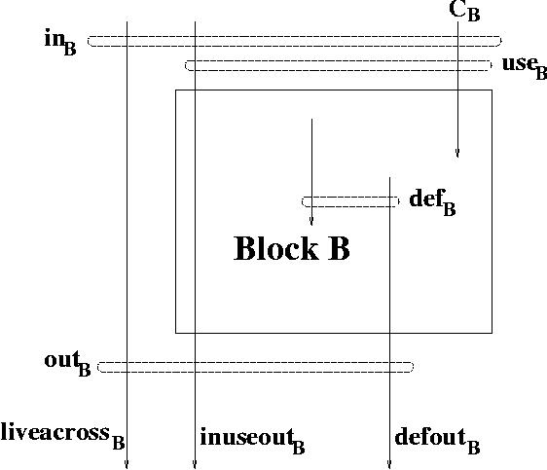
Variable use sets analysis
Total register needs ||liveacross _{B} ^{R}|| + max(||defout _{B}|| + ||inuseout _{B}||, k)
||S|| Cardianility of set S
S ^{R} Subset of S which gets registers

Slide 23
Results and Validation
Execution time estimates for selected 8 benchmark applications with varying register file sizes
Validations are done for two processors
  ARM7TDMI (ARM RISC Processor core)
  TM-1000 (Trimedia 5-issue VLIW processor)

Slide 24
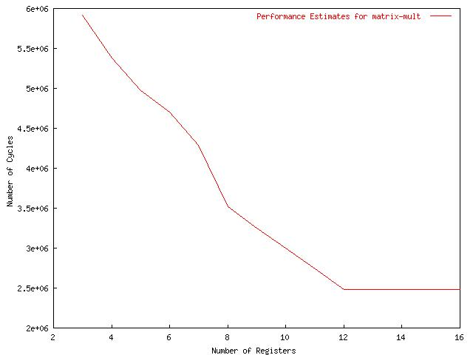
Excution time for matrix-mult with diff. Register file sizes for ARM7TDMI

Slide 25
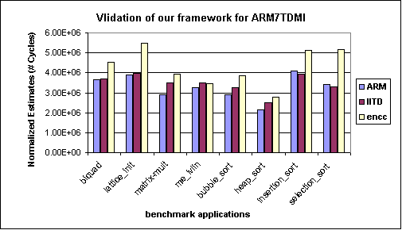
Validation of ASSIST for ARM7TDMI processor

Slide 26
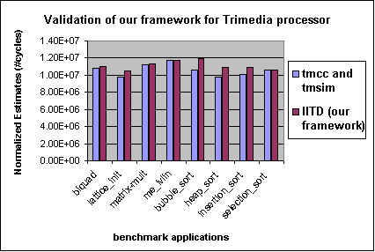
Validation of ASSIST for TM-1000 processor

Slide 27
Conclusions
Register allocation is performed before scheduling
Consider global needs
No target specific code generation or simulation
Simple processor description, retargetable
Performance is estimated using a scheduler and profile values
Validated for ARM7TDMI and TM-1000 processors
Nearly 77 times faster compared to compiler simulator framework

Slide 28
Future work
Explore complete storage organization considering register file size, number of register windows and multi level cache memories in a scheduler based technique

Slide 29
Thanks

Slide 30
Maximum variation in results
Benchmark Program | Performance |  | Power |  | Energy
 | Reg. size | % inc. | Reg. size | % red. | Reg. size | % red.
biquad_N_sections | 3 → 4 | 57.5 | 3 → 4 | 12.6 | 3 → 4 | 62.9
lattice_init | 4 → 5 | 20.5 | 6 → 7 | 1.0 | 4 → 5 | 21.0
matrix-mult | 3 → 4 | 29.7 | 7 → 8 | 7.4 | 3 → 4 | 33.4
me_ivlin | 3 → 4 | 53.4 | 5 → 6 | 15.3 | 3 → 4 | 59.3
bubble_sort | 4 → 5 | 46.3 | 4 → 5 | 17.3 | 4 → 5 | 55.6
heap_sort | 6 → 7 | 25.6 | 6 → 7 | 10.3 | 6 → 7 | 33.2
insertion_sort | 4 → 5 | 44.8 | 4 → 5 | 22.3 | 4 → 5 | 57.1
election_sort | 3 → 4 | 22.2 | 5 → 6 | 14.0 | 5 → 6 | 30.1
Average |  | 37.5 |  | 12.5 |  | 44.1

Slide 31
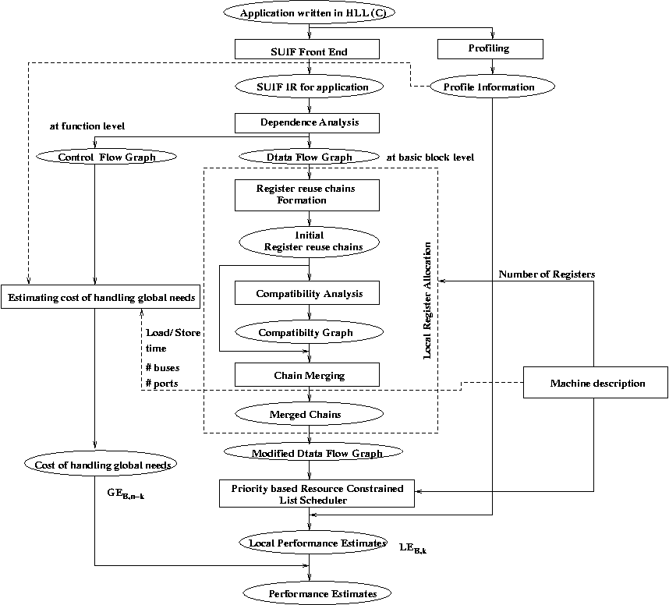

Slide 32
Sample machine description
MACHINE ISSUE SLOTS 1
REGISTERS 16
NUMBER OF PIPELINE STAGES 4
PIPELINE STAGES IF ID EX WB
NUMBER OF WRITE BUSES 1
FU alu
NUMBER 1
OPERATIONS io_ldc 1 io_cpy 1 io_add 1 io_sub 1 io_neg 1 io_not 1 io_and 1 io_ior 1 io_xor 1 io_abs 1 io_cvt 2 io_seq 1 io_sne 1 io_sl 1 io_sle 1 io_min 2 io_max 2 io_abs 2 io_mul 3 io_lod 2 io_str 1 io_memcpy 3 io_asr 2 io_lsl 2 io_lsr 2 io_rot 2 io_btrue 4 io_bfalse 4 io_jmp 3 io_cal 24 io_ret 3 io_lab 1 io_mbr 4 io_seq 2 io_sne 2 io_sl 2 io_sle 2 io_div 3 io_rem 3 io_mod 3 io_divfloor 1 io_divceil 1
SLOTS 1 : 1

